Slide 1
Computer Architecture Experiment 5－Memory Hierarchy
Jiang Xiaohong

Slide 2
Outline
Experiment Purpose
Experiment Task
Basic Principle
Operating Procedures
Precaution
Checkpoints

Slide 3
Experiment Purpose
Understanding the principle of Memory Hierarchy
Implement CPU with cache and memory by two steps
Implement a CPU accessing memory in multiple cycle Implement a CPU with cache – memory two level hierarchy

Slide 4
Part I CPU access Mem in multiple cycles
Understand the principle of CPU accessing Mem. in multiple cycles.
Master the design methods of pipelined CPU accessing Mem. in multiple cycle.
master methods of program verification of Pipelined CPU accessing Mem. in multiple cycle.

Slide 5
Experiment Task
Design of Pipelined CPU accessing Mem. in multiple cycle
Redesign Inst. ROM & Data RAM
Modify CPU Controller
Modify datapath
Verify the Pipelined CPU with program and observe the execution of program

Slide 6
Inst. ROM’s Job
Initial State: S_IDLE
Working State: S_READ
Read for 8 cycles, then output the value, set the signal ACK
STALL = CS & ~ACK

Slide 7
Data RAM’s Job
Initial State: S_IDLE
Working State: S_READ/S_WRITE (according to signal we)
Read/Write for 8 cycles, then output the value/write the value, set the signal ACK
STALL = CS & ~ACK

Slide 8
When ROM&RAM STALL
Inst. ROM Stalls, Stall should be in ID stage otherwise jump indicator would be lost
if_en=0, id_en=0, rst_exe=1
DATA RAM stalls
…, rst_wb=1

Slide 9
Add TCR in CP0
TCR - Tick Counter Register
TCR ++ when System Clock
Cycle goes on
// CP0 registers
localparam
//CP0_SR = 0,
//CP0_EAR = 1,
CP0_EPCR = 2,
CP0_EHBR = 3,
//CP0_IER = 4,
//CP0_ICR = 5,
//CP0_PDBR = 6,
//CP0_TIR = 7,
//CP0_WDR = 8,
CP0_TCR = 9;

Slide 10
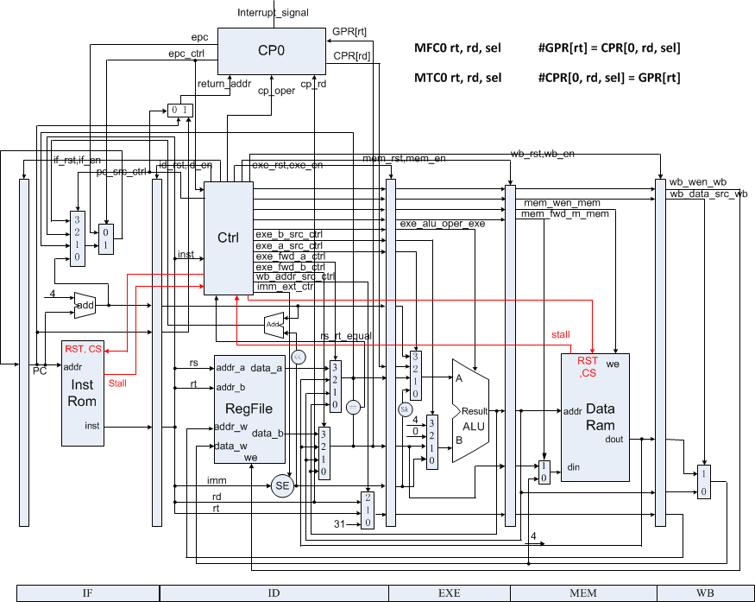
Datapath of CPU accessing Mem. in multiple cycle

Slide 11
Code Example (1)
module inst_rom (
input wire clk,
input wire rst,
input wire cs,
input wire [31:0] addr,
output reg [31:0] dout,
output reg stall
);

Slide 12
Code Example (2)
module data_ram (
input wire clk,
input wire rst,
input wire cs,
input wire we,
input wire [31:0] addr,
input wire [31:0] din,
output reg [31:0] dout,
output reg stall
);

Slide 13
Instr. Mem.(1)
0: 3c010000 lui R1,0x0 //main entry
4: 24210040 addiu R1,R1,64
8: 40811800 mtc0 R1, R3
c: 00001020 add R2,R0,R0
10: 00001820 add R3,R0,R0
14: 40044800 mfc0 R4,R9
18: 00002820 add R5,R0,$0
1c: 20420001 addi R2,R2,1 //loop
20: 28412710 slti R1,R2,10000
24: 1420fffd bne $1,R0,-2 //jump to loop
28: 00000000 nop

Slide 14
Instr. Mem.(2)
2c: 40054800 mfc0 R5, R9
30: 00a42822 sub R5, R5, R4
34: 20420001 addi R2,R2,1 //loop
38: 0800000d j 34
3c: 00000000 nop
40: 20630001 addi R3,R3,1 //handler
44: 42000018 eret
48: 00000000 nop

Slide 15
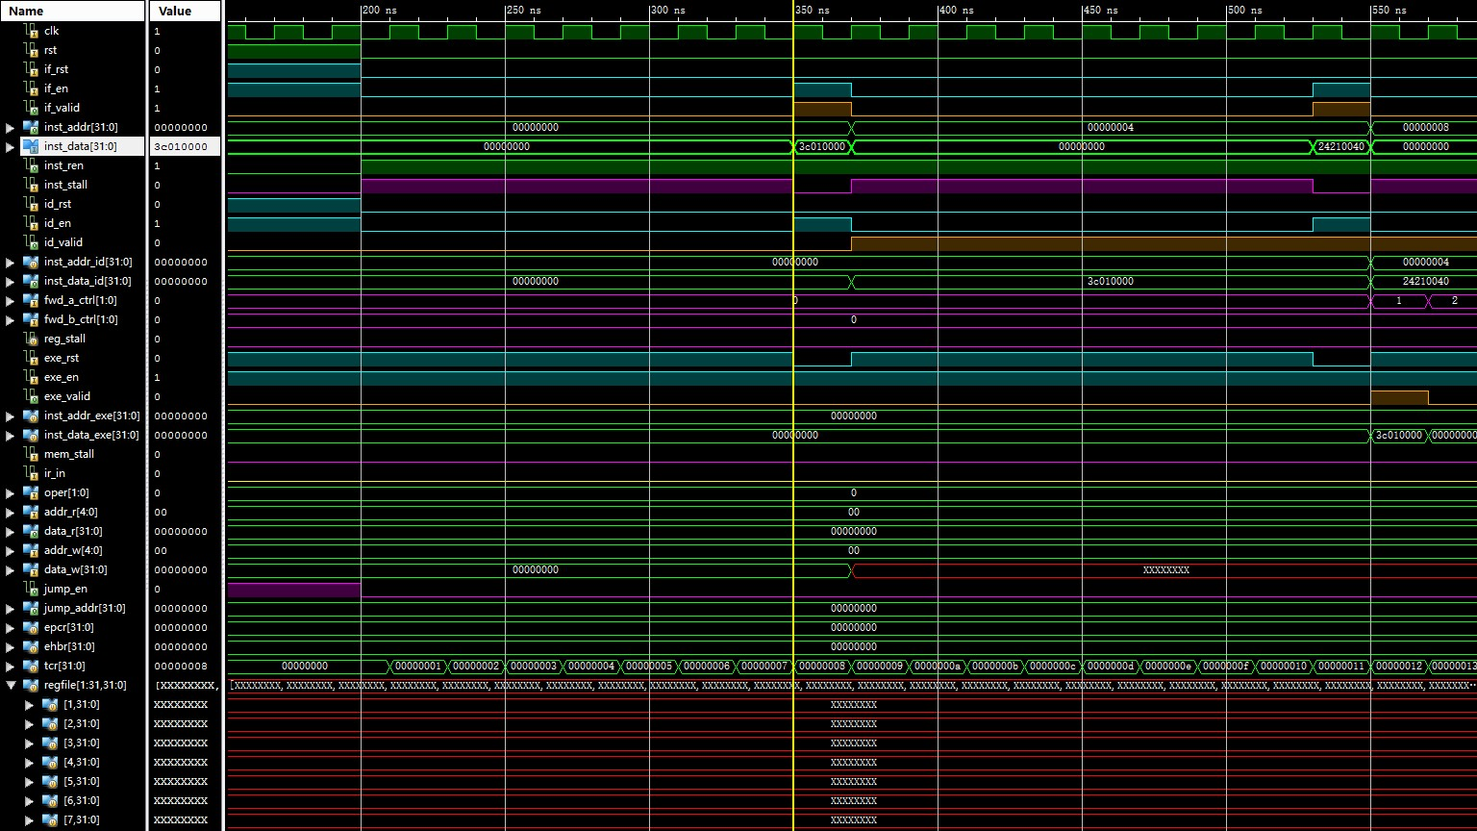
Simulation (1)

Slide 16
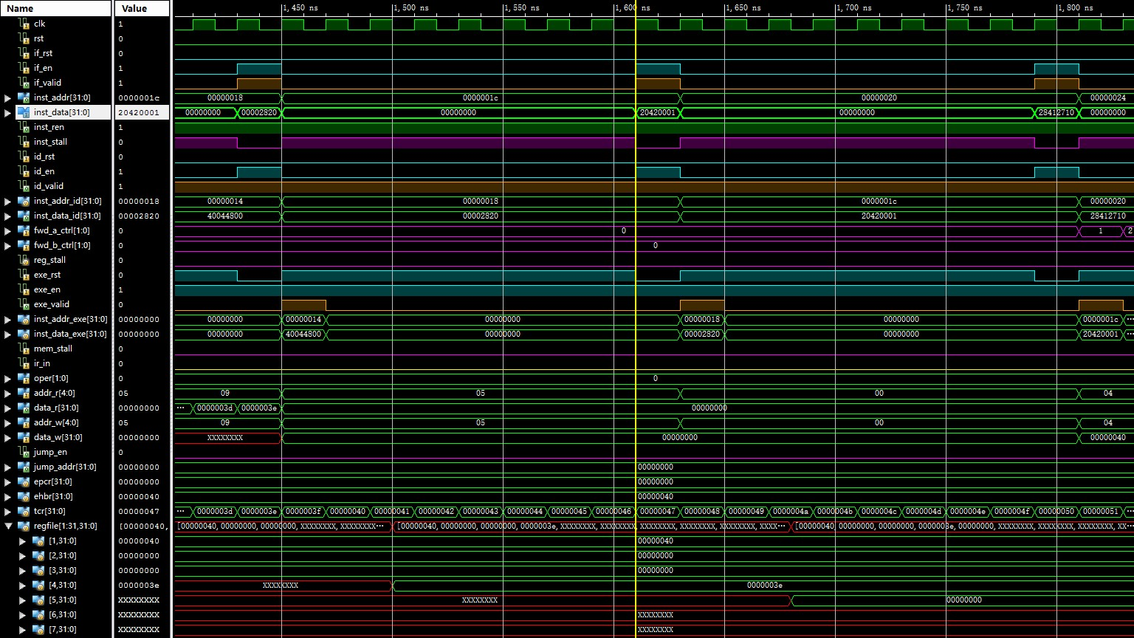
Simulation (2)

Slide 17
Checkpoints
CP 1:
Waveform Simulation of the Pipelined CPU with the verification program
CP 2:
FPGA Implementation of the Pipelined CPU with the verification program

Slide 18
Part II Cache design
Understand Cache Line.
Understand the principle of Cache Management Unit (CMU) and State Machine of CMU.
Master the design methods of CMU.
Master the design methods of Cache Line.
master verification methods of Cache Line.

Slide 19
Experiment Task
Design of Cache Line and CMU.
Verify the Cache Line and CMU.
Observe the Waveform of Simulation.

Slide 20
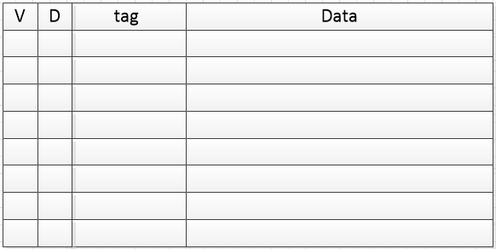
Cache Line

Slide 21

Cache Mode
Direct Map
Write Back
Write Allocate

Slide 22
Address
Bytes of word = 4, WORD_BYTES_WIDTH = 2
Words of line = 4, LINE_WORDS_WIDTH = 2
Tag bits = 22
Address bits = 32
LINE_INDEX_WIDTH = ADDR_BITS - TAG_BITS - LINE_WORDS_WIDTH - WORD_BYTES_WIDTH = ?
Line Number = 64
Notes:
6
2^6 = 32

Slide 23
Cache Line Memory
reg [LINE_NUM-1:0] inner_valid = 0;
reg [LINE_NUM-1:0] inner_dirty = 0;
reg [TAG_BITS-1:0] inner_tag [0:LINE_NUM-1];
reg [WORD_BITS-1:0] inner_data [0:LINE_NUM*LINE_WORDS-1];

Slide 24
Input and output Signals of Cache Line
module cache (
input wire clk, // clock
input wire rst, // reset
input wire [ADDR_BITS-1:0] addr, // address
input wire store, // set valid to 1 and reset dirty to 0
input wire edit, // set dirty to 1
input wire invalid, // reset valid to 0
input wire [WORD_BITS-1:0] din, // data write in
output wire hit, // hit or not
output reg [WORD_BITS-1:0] dout, // data read out
output reg valid, // valid bit
output reg dirty, // dirty bit
output reg [TAG_BITS-1:0] tag // tag bits
);

Slide 25
Read and Write Cache
dout <= inner_data[addr[ADDR_BITS-TAG_BITS-1:WORD_BYTES_WIDTH]];
if (store || edit)
inner_data[addr[ADDR_BITS-TAG_BITS-1:WORD_BYTES_WIDTH]] <= din;

Slide 26
Dirty, Valid, tag of Cache
invalid
inner_valid[addr[ADDR_BITS-TAG_BITS-1:LINE_WORDS_WIDTH+WORD_BYTES_WIDTH]] <=?
inner_dirty[addr[ADDR_BITS-TAG_BITS-1:LINE_WORDS_WIDTH+WORD_BYTES_WIDTH]] <= ?
load
inner_valid[addr[ADDR_BITS-TAG_BITS-1:LINE_WORDS_WIDTH+WORD_BYTES_WIDTH]] <=?
inner_dirty[addr[ADDR_BITS-TAG_BITS-1:LINE_WORDS_WIDTH+WORD_BYTES_WIDTH]] <=?
inner_tag[addr[ADDR_BITS-TAG_BITS-1:LINE_WORDS_WIDTH+WORD_BYTES_WIDTH]] <=?
edit
inner_dirty[addr[ADDR_BITS-TAG_BITS-1:LINE_WORDS_WIDTH+WORD_BYTES_WIDTH]] <=?
inner_tag[addr[ADDR_BITS-TAG_BITS-1:LINE_WORDS_WIDTH+WORD_BYTES_WIDTH]] <=?

Slide 27
output of Dirty, Valid, tag, hit
valid <= inner_valid[addr[ADDR_BITS-TAG_BITS-1:LINE_WORDS_WIDTH+WORD_BYTES_WIDTH]]
dirty <= inner_dirty[addr[ADDR_BITS-TAG_BITS-1:LINE_WORDS_WIDTH+WORD_BYTES_WIDTH]]
tag <= inner_tag[addr[ADDR_BITS-TAG_BITS-1:LINE_WORDS_WIDTH+WORD_BYTES_WIDTH]]
hit = ?? & ??

Slide 28
Simulation Example
#210 load = 1; din = 32'h11111111; addr = 32'h00000000;
#20 addr = 32'h00000004;
#20 addr = 32'h000000A8;
#20 addr = 32'h0000001C;
#20 load = 0; addr = 32'h000000B4; din = 0;
#100 edit = 1; din = 32'h22222222; addr = 32'h00000008;
#100 edit = 0; din = 0; addr = 0;
initial forever #10 clk = ~clk;

Slide 29
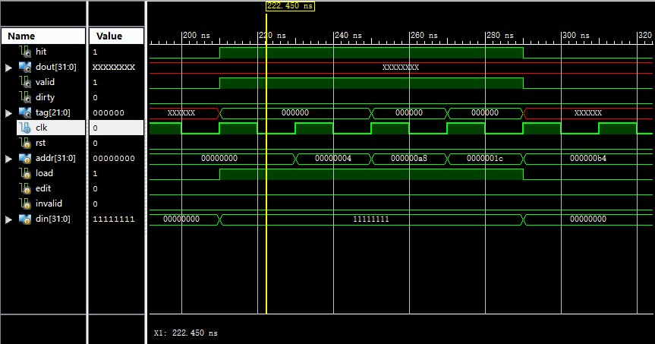
Simulation Example

Slide 30
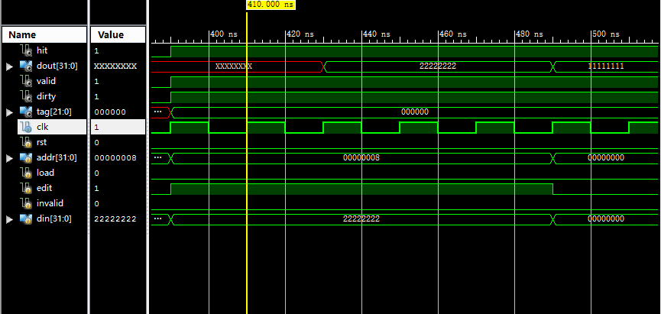
Simulation Example

Slide 31
Simulation
Write Simulation Code yourself
cache initialization
read
miss
hit
write
miss
hit

Slide 32
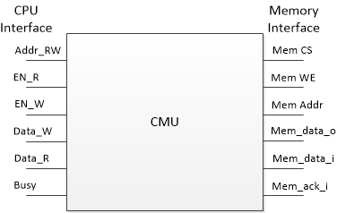
Cache Management Unit

Slide 33
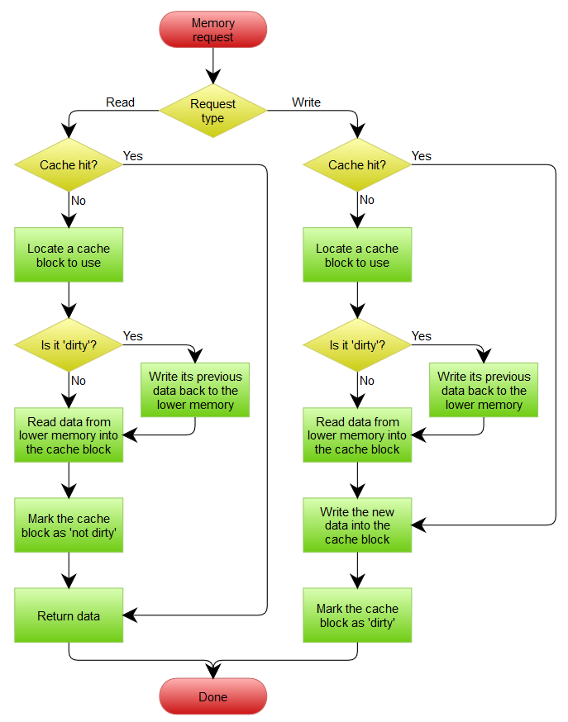
Cache Operation Flow
Read (Hit/Miss)
Write (Hit/Miss)
Replace (Clean/Dirty)

Slide 34
Cache Management State Machine
Read/Write Hit
Writing Back
Miss & Dirty
S_IDLE
S_BACK
S_BACK_WAIT
Miss & Clean
S_FILL
S_FILL_WAIT
Reading Allocate
Notes:
S_IDLE：空闲状态，不进行Memory操作。
S_BACK：将数据写回到Memory，由计数器控制直到整个Cache Line 全部写回。
S_BACK_WAIT：等待一个时钟，需要释放对Memory的片选以准备下次操作。
S_FILL：从Memory读取数据，由计数器控制直到整个Cache Line 全部读取完毕。
S_FILL_WAIT：等待一个时钟，保证最后一个数据成功写入Cache。

Slide 35
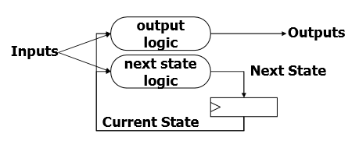
State Machine
Next State Logic
State assignment
Output

Slide 36
Next logic (1)
S_IDLE: begin
if (en_r || en_w) begin
if (cache_hit)
next_state = S_IDLE;
else if (cache_valid && cache_dirty)
next_state = S_Back;
else
next_state = S_FILL;
end
end
S_BACK: begin
if (mem_ack_i)
next_word_count = word_count + 1'h1;
else
next_word_count = word_count;
if (mem_ack_i && word_count == {LINE_WORDS_WIDTH{1'b1}})
next_state = ???;
else
next_state = ???;
end

Slide 37
Next logic (2)
S_BACK_WAIT: begin
next_word_count = 0;
next_state = ???;
end
S_FILL: begin
if (mem_ack_i)
next_word_count = word_count + 1'h1;
else
next_word_count = word_count;
if (mem_ack_i && word_count == {LINE_WORDS_WIDTH{1'b1}})
next_state = ???;
else
next_state = ???;
end
S_FILL_WAIT: begin
next_word_count <= 0;
next_state <= ???;
end

Slide 38
Perform State Assignment
always @(posedge clk) begin
if (rst) begin
state <= 0;
word_count <= 0;
end
else begin
state <= next_state;
word_count <= next_word_count;
end
end

Slide 39
Output (1)
case (next_state)
S_IDLE: begin
cache_addr = addr_rw;
cache_edit = en_w;
cache_din = data_w;
end
S_BACK, S_BACK_WAIT: begin
cache_addr = {addr_rw[31:LINE_WORDS_WIDTH+2], next_word_count, 2'b00};
end
S_FILL, S_FILL_WAIT: begin
cache_addr = {addr_rw[31:LINE_WORDS_WIDTH+2], word_count_buf, 2'b00};
cache_din = mem_data_syn;
cache_store = mem_ack_syn;
end
endcase

Slide 40
Output (2)
case (next_state)
S_IDLE, S_BACK_WAIT, S_FILL_WAIT: begin
mem_cs_o <= 0;
mem_we_o <= 0;
mem_addr_o <= 0;
end
S_BACK: begin
mem_cs_o <= 1;
mem_we_o <= 1;
mem_addr_o <= {cache_tag, addr_rw[31-TAG_BITS:LINE_WORDS_WIDTH+2], next_word_count, 2'b00};
end
S_FILL: begin
mem_cs_o <= 1;
mem_we_o <= 0;
mem_addr_o <= {addr_rw[31:LINE_WORDS_WIDTH+2], next_word_count, 2'b00};
end
endcase

Slide 41
Simulation (1)
module inst (
input wire clk,
input wire rst,
input wire [3:0] index, // instruction index
output wire valid, // stop running if valid is 0
output wire write, // write enable signal for cache
output wire [31:0] addr // address for cache
);
reg [33:0] data [0:7];
initial begin // clock cycles are only for reference
data[0] = 34'h200000004; // read miss 1+17
data[1] = 34'h300000018; // write miss 1+17
data[2] = 34'h200000008; // read hit 1
data[3] = 34'h300000014; // write hit 1
data[4] = 34'h210000004; // read & clean replace 1+17
data[5] = 34'h310000018; // write & dirty replace 1+17*2
data[6] = 34'h310000008; // write hit 1
data[7] = 34'h0; // end total: 92
end
assign
valid = data[index][33],
write = data[index][32],
addr = data[index][31:0];
endmodule

Slide 42
Simulation (2)
always @(posedge clk) begin
if (rst)
index <= 0;
else if (valid && ~stall)
index <= index + 1'h1;
end
// ram
wire mem_cs;
wire mem_we;
wire [31:0] mem_addr;
wire [31:0] mem_din;
wire [31:0] mem_dout;
wire mem_ack;
data_ram #(
.ADDR_WIDTH(5),
.CLK_DELAY(3)
) RAM (
.clk(clk),
.rst(rst),
.addr({26'b0, mem_addr[5:0]}),
.cs(mem_cs),
.we(mem_we),
.din(mem_din),
.dout(mem_dout),
.stall(),
.ack(mem_ack)
);
`timescale 1ns / 1ps
module top (
input wire clk,
input wire rst,
output reg [7:0] clk_count = 0,
output reg [7:0] inst_count = 0,
output reg [7:0] hit_count = 0
);
// instruction
reg [3:0] index = 0;
wire valid;
wire write;
wire [31:0] addr;
wire stall;
inst INST (
.clk(clk),
.rst(rst),
.index(index),
.valid(valid),
.write(write),
.addr(addr)
);

Slide 43
Simulation (3)
// counter
reg stall_prev;
always @(posedge clk) begin
if (rst)
stall_prev <= 0;
else
stall_prev <= stall;
end
always @(posedge clk) begin
if (rst) begin
clk_count <= 0; // 时钟计数
inst_count <= 0; // 指令计数
hit_count <= 0; // 命中计数
end
else if (valid) begin
clk_count <= clk_count + 1'h1;
inst_count <= index + 1'h1;
if (~stall_prev && ~stall)
hit_count <= hit_count + 1'h1;
end
end
endmodule
// cache
cmu CMU (
.clk(clk),
.rst(rst),
.addr_rw(addr),
.en_r(~write),
.data_r(),
.en_w(write),
.data_w({16'h5678, clk_count, inst_count}),
.stall(stall),
.mem_cs_o(mem_cs),
.mem_we_o(mem_we),
.mem_addr_o(mem_addr),
.mem_data_i(mem_dout),
.mem_data_o(mem_din),
.mem_ack_i(mem_ack)
);

Slide 44
Simulation (4)
module sim_top;
// Inputs
reg clk;
reg rst;
// Outputs
wire [7:0] clk_count;
wire [7:0] inst_count;
wire [7:0] hit_count;
// Instantiate the Unit Under Test (UUT)
top uut (
.clk(clk),
.rst(rst),
.clk_count(clk_count),
.inst_count(inst_count),
.hit_count(hit_count)
);
initial begin
// Initialize Inputs
clk = 0;
rst = 1;
// Wait 100 ns for global reset to finish
#95 rst = 0;
// Add stimulus here
end
initial forever #10 clk = ~clk;
endmodule

Slide 45
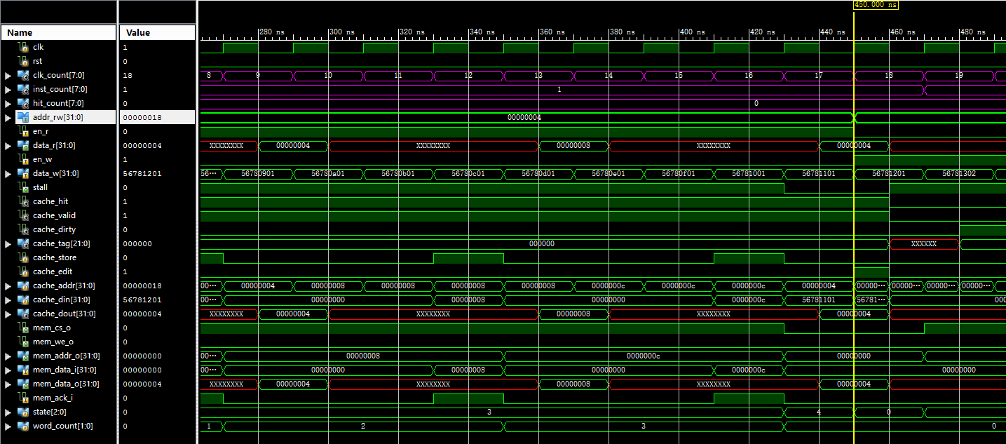
Result (1)
Read miss at 0x00000004

Slide 46
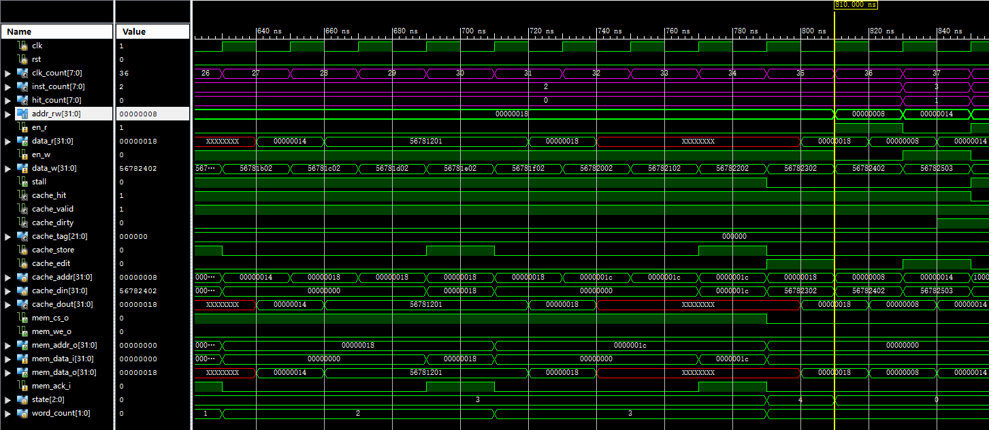
Result (2)
Write miss at 0x00000018
Read hit at 0x00000008
Write hit at 0x00000014

Slide 47
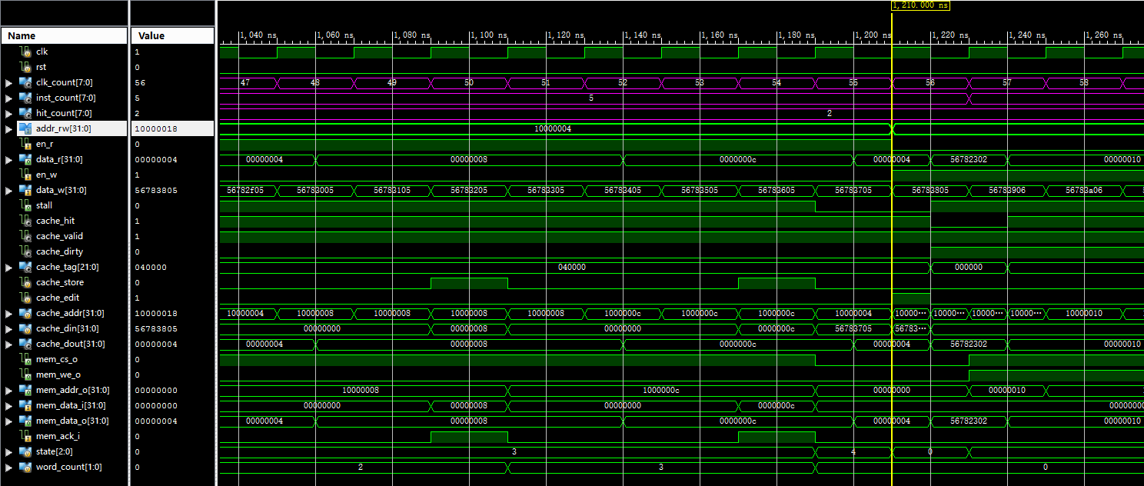
Result (3)
Read & clean replace at 0x10000004

Slide 48
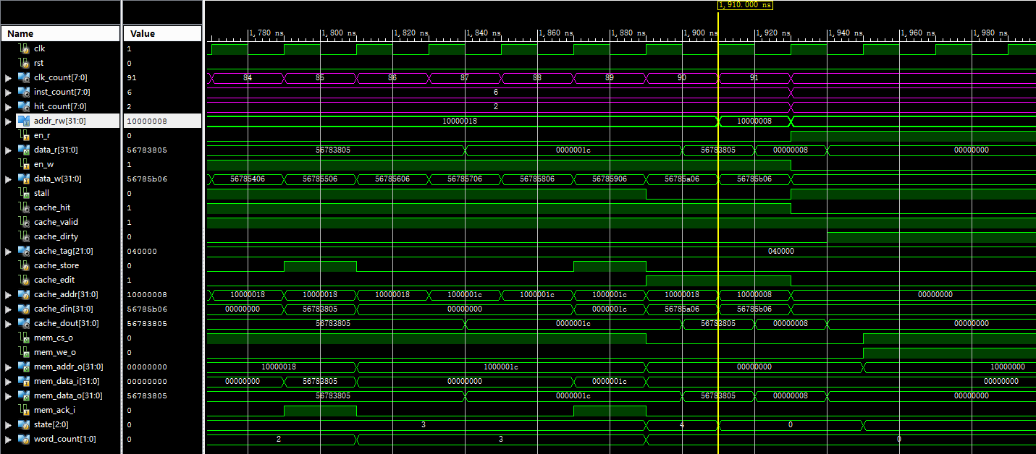
Result (4)
Write & dirty replace at 0x10000018
Write hit at 0x10000008

Slide 49
Performance Analysis
Miss Penalty
When clean, MP = 17
When dirty, MP = 34
Result
CLK_COUNT = 92
INST_COUNT = 7
HIT_COUNT = 3

Slide 50
Report
Including：
CP1:
Waveform Simulation of Cache Line.
CP2:
Waveform Simulation of CMU.

Slide 51
Checkpoint
Download FPGA board and test whether the pipeline can run with cache and memory correctly.
Give a signal to show whether cache is miss(light) or hit ?
Give a signal to show whether it’s a read or write ?

